Slide 1
System Timer (SysTick)

Slide 2
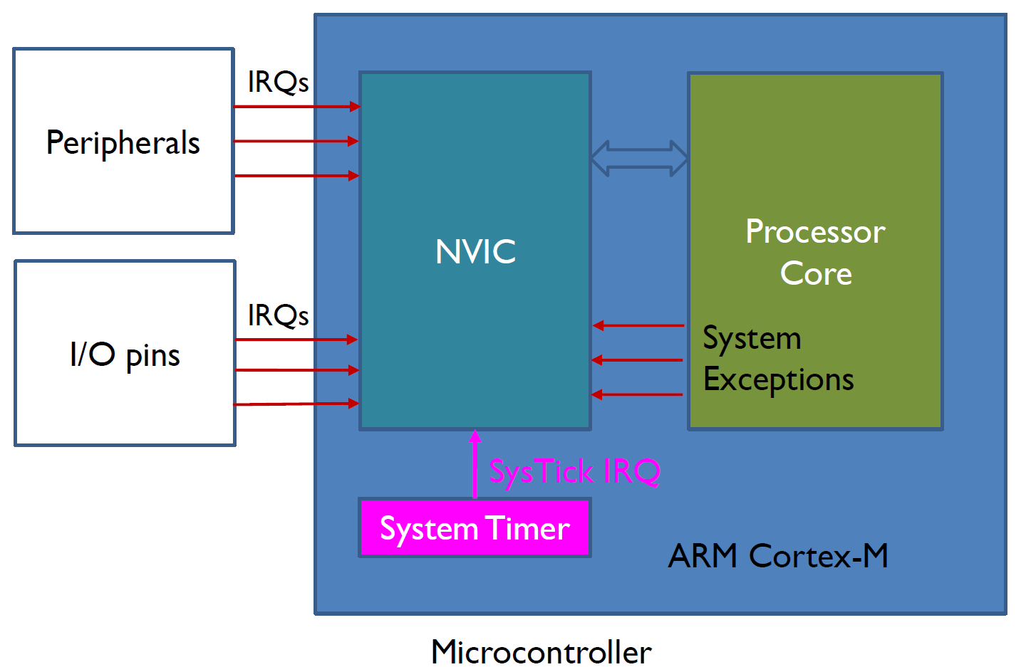
System Timer (SysTick)
System timer is a standard hardware component built into ARM Cortex-M.
This timer is dedicated to real-time operating systems, but could also be used as a standard downcounter.
It features:
A 24-bit downcounter
Autoreload capability
Maskable system interrupt generation when the counter reaches 0
Programmable clock source.

Slide 3
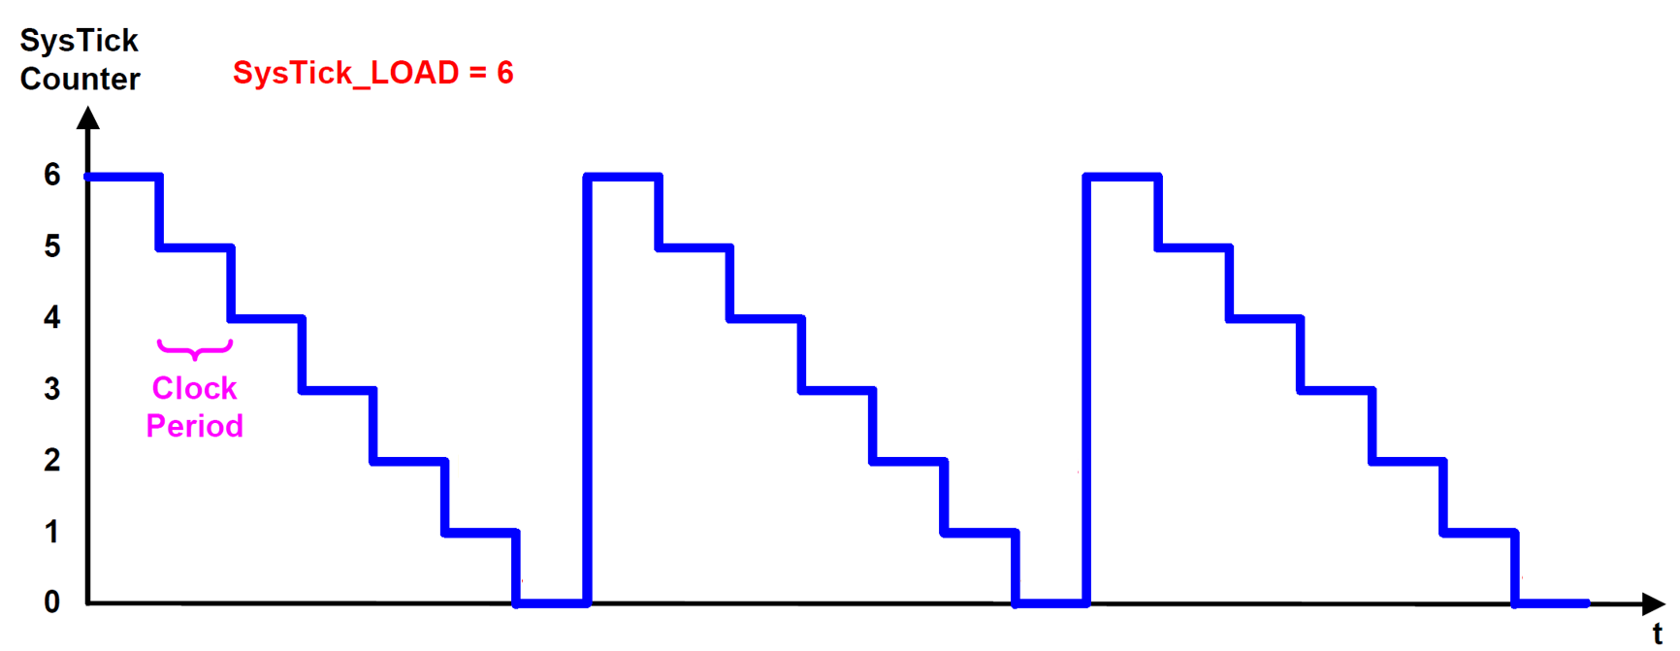
System Timer (SysTick)
System timer is a standard hardware component built into ARM Cortex-M.
Count Flag =1
Count Flag =1
Count Flag =1

Slide 4
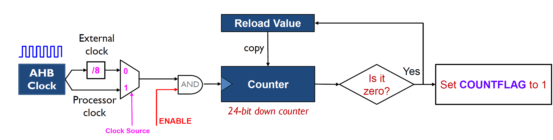
System Timer (SysTick)
System timer is a standard hardware component built into ARM Cortex-M.

Slide 5
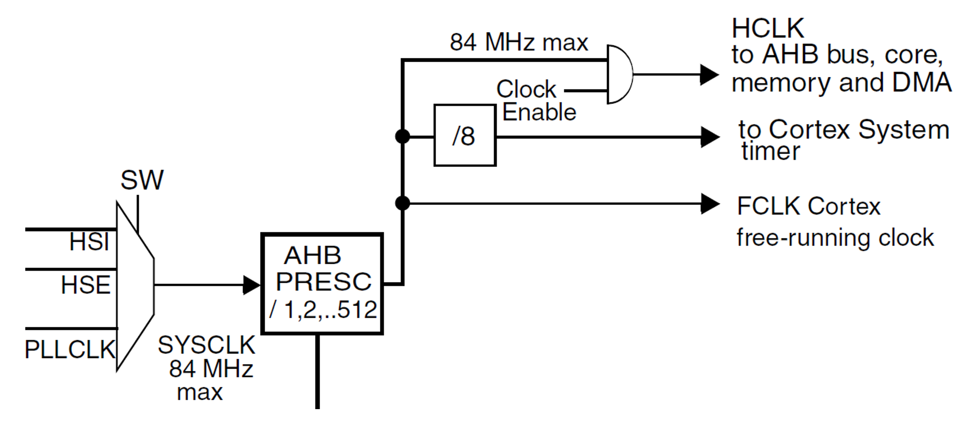

Clock tree
The RCC feeds the external clock of the Cortex System Timer (SysTick) with the AHB clock (HCLK) divided by 8.
The SysTick can work either with this clock or with the Cortex clock (HCLK), configurable in the SysTick control and status register.

Slide 6
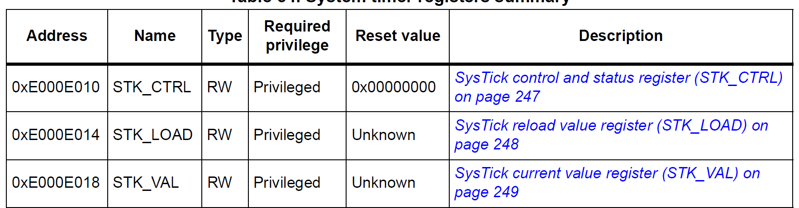
Registers of System Timer

Slide 7
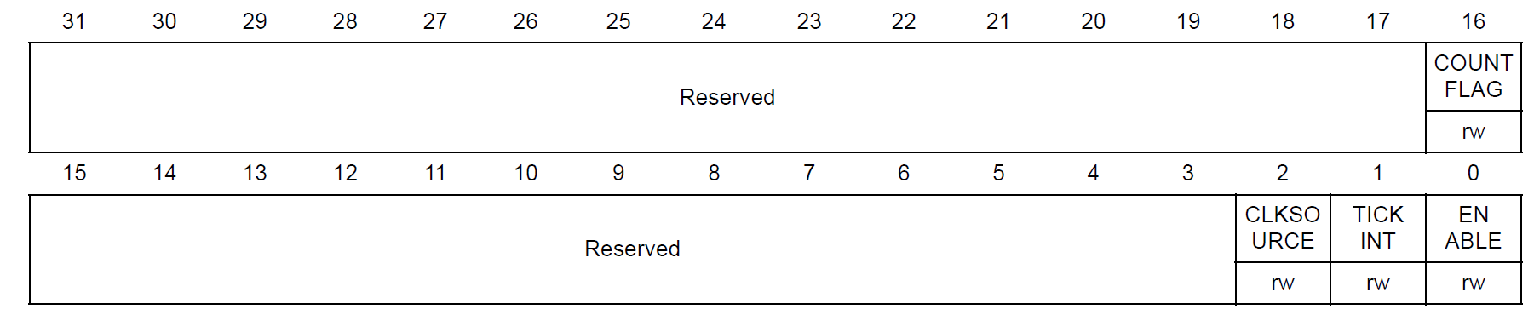
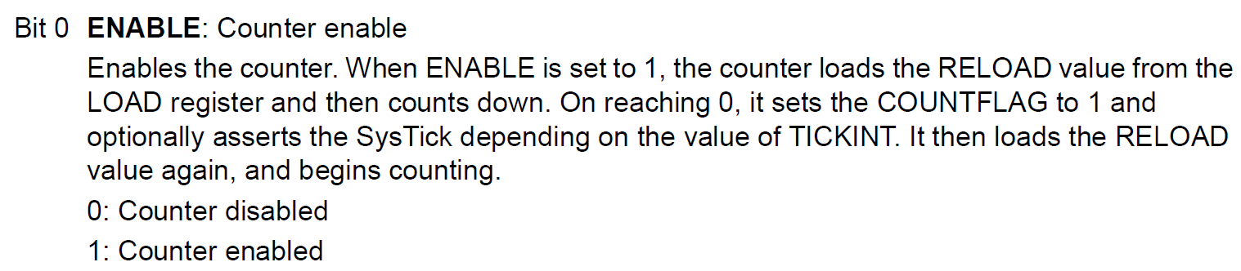
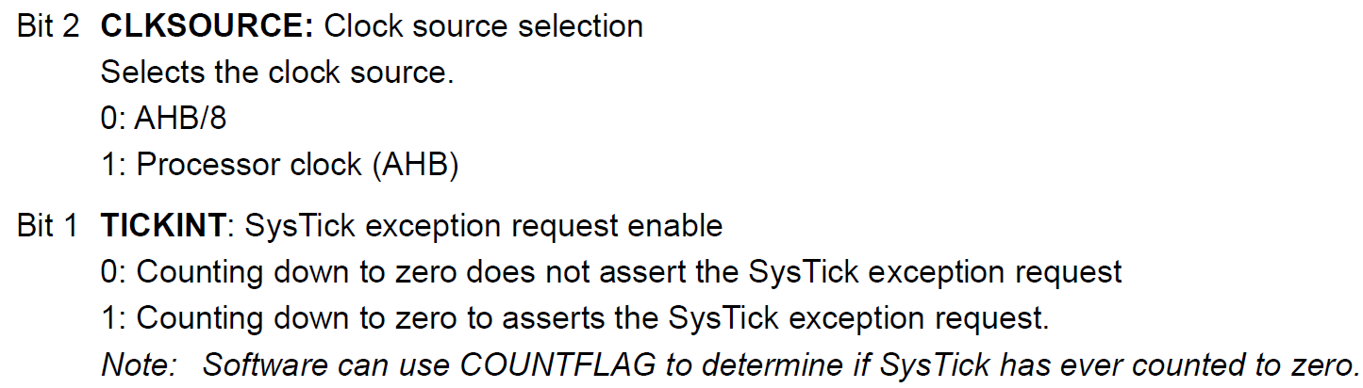
SysTick control and status register (STK_CTRL)
The SysTick CTRL register enables the SysTick features.

Slide 8
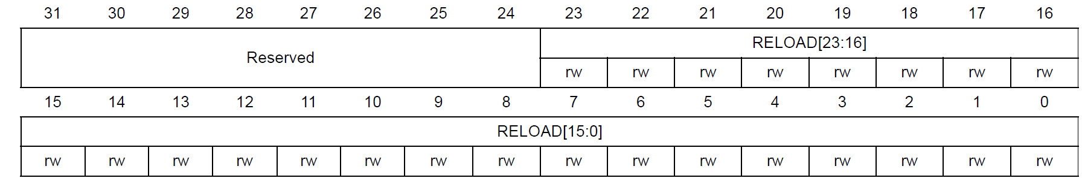
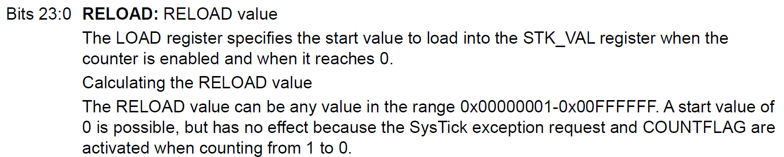
SysTick reload value register (STK_LOAD)

Slide 9
SysTick Load Value Formula
24 bits, maximum value 0x00FF.FFFF (16,777,215)
Counter counts down from RELOAD value to 0.
Reload Value (N) = Time Delay / (1 / Clock Frequency);
Reload Value (N) = Time Delay * Clock Frequency
Example
For a Time Delay of 1 second and a Clock Frequency of 16 MHz
Reload Value (N) = 1 / (1 / 16000000)
Reload Value (N) = 16000000
Clock Frequency: The clock frequency driving the SysTick timer (in this case, 16 MHz or 16,000,000 Hz).
Time Delay: The desired delay time, in seconds (in this case, 1 second).
The formula calculates how many clock cycles are needed to achieve the specified delay.
In this example, you need 16 million clock cycles to create a 1-second delay with a 16 MHz clock.
So, the LOAD register should be set to 16,000,000 to create a 1-second delay if the clock frequency is 16 MHz.

Slide 10
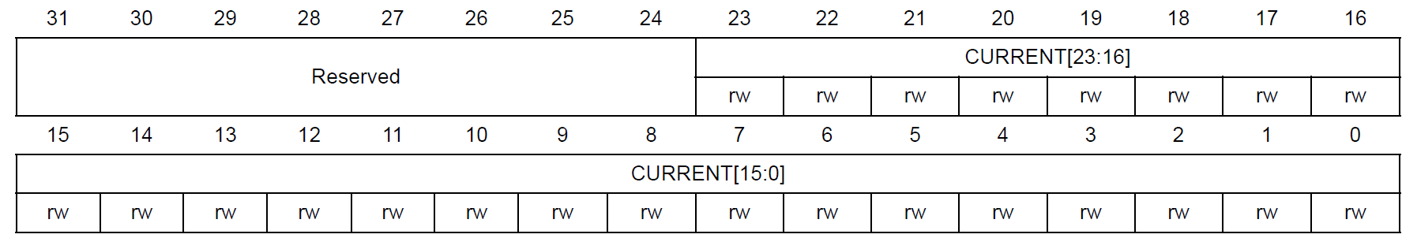
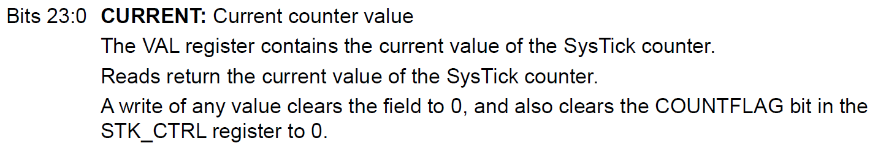
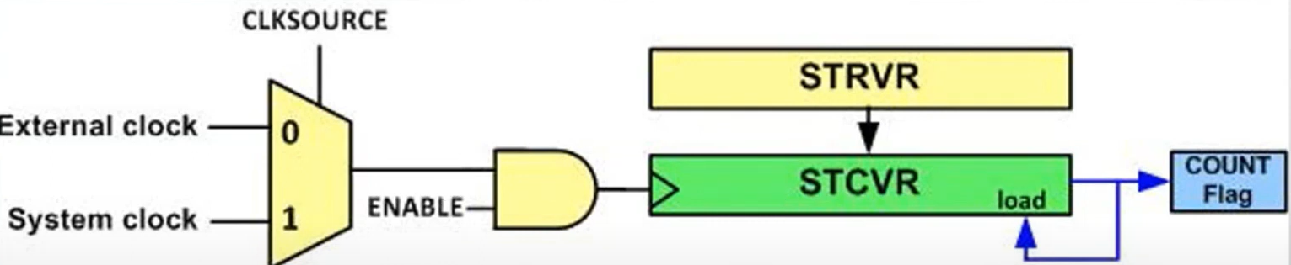
SysTick current value register (STK_VAL)

Slide 11
SysTick design hints and tips
The SysTick counter reload and current value are undefined at reset, the correct initialization sequence for the SysTick counter is:
1.Program reload value.
2. Clear current value.
3. Program Control and Status register.

Slide 12

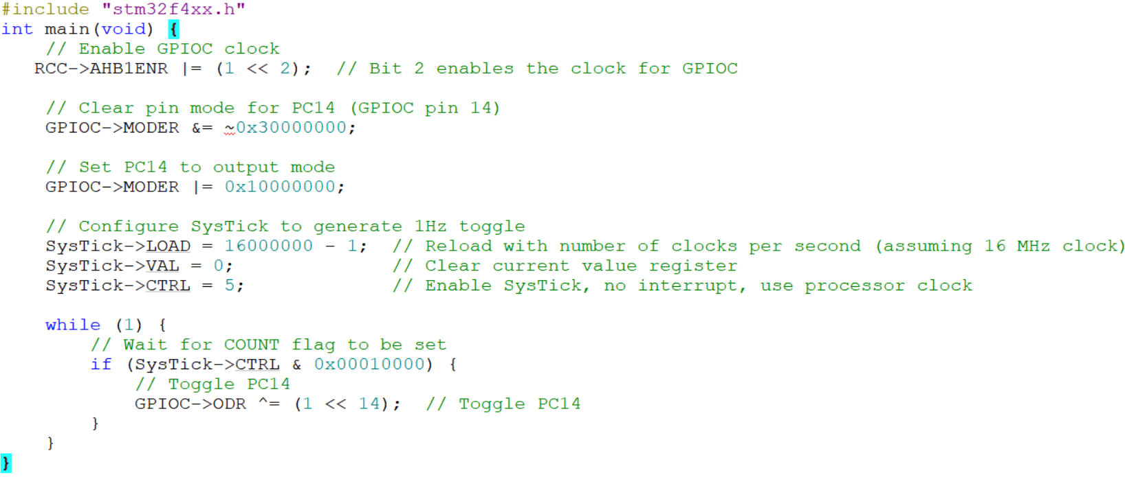
Toggle PC14 (LED1) with 1 s delay using SysTick

Slide 13
Thank You

